Slide 1
Intractability III
special cases: trees
special cases: planarity
approximation algorithms
exact exponential algorithms
Notes:
[wayne s13] this is a 1-lecture introduction to coping with intractability

Slide 2
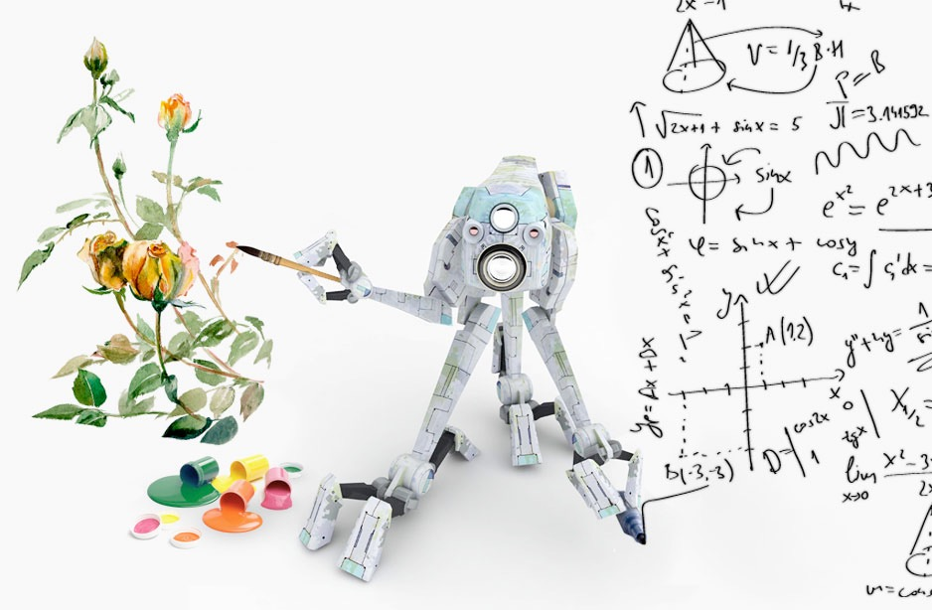
Coping with NP-completeness
Q. Suppose I need to solve an NP-hard problem. What should I do?
A. Sacrifice one of three desired features.
Solve arbitrary instances of the problem.
Solve problem to optimality.
Solve problem in polynomial time.
Coping strategies.
Design algorithms for special cases of the problem.
Design approximation algorithms or heuristics.
Design algorithms that may take exponential time.
Notes:
Prove P = NP.

Slide 3
Intractability III
special cases: trees
special cases: planarity
approximation algorithms
exact exponential algorithms

Slide 4
Independent set on trees
Independent set on trees. Given a tree, find a maximum cardinality subset of nodes such that no two are adjacent.
Fact. A tree has at least one node that is a leaf (degree = 1).
Key observation. If node v is a leaf, there exists a max cardinality independent set containing v.
Pf. [exchange argument]
Consider a max cardinality independent set S.
If v ∈ S, we're done.
Let (u, v) be some edge.
if u ∉ S and v ∉ S, then S ∪ { v } is independent ⇒ S not maximum
if u ∈ S and v ∉ S, then S ∪ { v } − { u } is independent ▪
u
v
Notes:
a tree with n >= 2 has at least 2 leaf nodes

Slide 5
Independent set on trees: greedy algorithm
Theorem. The following greedy algorithm finds a max cardinality independent set in forests (and hence trees).
Pf. Correctness follows from the previous key observation. ▪
Remark. Can implement in O(n) time by considering nodes in postorder.
Independent-Set-In-A-Forest (F)
_____________________________________________________________________________________________________________________________________________________________________________________________________________________________________________________________________________________________________________________________________________________________________________________________________________________________________________________________________________________________________________________________________________________________________________________________________________________________________________________________________________________________________________________________________________________________________________________________________________________________________________________________________________________________________________________________________________________________________________________________________________________________________________________________________________________________________________________________________________________________________________________________________________________________________________________________________________
S ← ∅.
While (F has at least 1 edge)
e ← (u, v) such that v is a leaf.
S ← S ∪ { v }.
F ← F – { u, v }.
Return S ∪ { nodes remaining in F }.
_____________________________________________________________________________________________________________________________________________________________________________________________________________________________________________________________________________________________________________________________________________________________________________________________________________________________________________________________________________________________________________________________________________________________________________________________________________________________________________________________________________________________________________________________________________________________________________________________________________________________________________________________________________________________________________________________________________________________________________________________________________________________________________________________________________________________________________________________________________________________________________________________________________________________________________________________________________
delete u and v and all incident edges

Slide 6
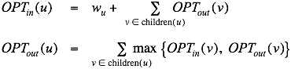
Weighted independent set on trees
Weighted independent set on trees. Given a tree and node weights w_{v} > 0, find an independent set S that maximizes Σ_{v ∈ S} w_{v}.
Dynamic programming solution. Root tree at some node, say r.
OPT_{in} (u) = max weight independent set of subtree rooted at u, containing u.
OPT_{out} (u) = max weight independent set of subtree rooted at u, not containing u.
OPT = max { OPT_{in} (r), OPT_{out} (r) }.
r
u
v
w
x
children(u) = { v, w, x }
Notes:
Intuition. If (u, v) is an edge such that v is a leaf node, then either OPT includes u or OPT includes all leaf nodes incident to u.
Observation: provides intuition to work from leaves upwards. Can think of contracting subtree.

Slide 7
Weighted independent set on trees: dynamic programming algorithm
Theorem. The dynamic programming algorithm finds a max weighted independent set in a tree in O(n) time.
can also find independent set itself
(not just value)
Weighted-Independent-Set-In-A-Tree (T)
_____________________________________________________________________________________________________________________________________________________________________________________________________________________________________________________________________________________________________________________________________________________________________________________________________________________________________________________________________________________________________________________________________________________________________________________________________________________________________________________________________________________________________________________________________________________________________________________________________________________________________________________________________________________________________________________________________________________________________________________________________________________________________________________________________________________________________________________________________________________________________________________________________________________________________________________________________________
Root the tree T at a node r.
S ← ∅.
Foreach (node u of T in postorder)
If (u is a leaf)
Min[u] = wu.
Mout[u] = 0.
Else
Min[u] = wu + Σv ∈ children(u) Mout[v].
Mout[u] = Σv ∈ children(u) max { Min[v], Mout[v] }.
Return max { Min[r], Mout[r] }.
_____________________________________________________________________________________________________________________________________________________________________________________________________________________________________________________________________________________________________________________________________________________________________________________________________________________________________________________________________________________________________________________________________________________________________________________________________________________________________________________________________________________________________________________________________________________________________________________________________________________________________________________________________________________________________________________________________________________________________________________________________________________________________________________________________________________________________________________________________________________________________________________________________________________________________________________________________________
ensures a node is visited
after all its children
Notes:
Takes O(n) time since we visit nodes in postorder and examine each edge exactly once.

Slide 8
NP-hard problems on trees: context
Independent set on trees. Tractable because we can find a node that breaks the communication among the subproblems in different subtrees.
Linear-time on trees. Vertex-Cover, Dominating-Set, Graph-Isomorphism, ...
u

Slide 9
Intractability III
special cases: trees
special cases: planarity
approximation algorithms
exact exponential algorithms
Section 23.1

Slide 10
Planarity
Def. A graph is planar if it can be embedded in the plane in such a way that no two edges cross.
Applications. VLSI circuit design, computer graphics, ...
K₅ is nonplanar
K_{3,3} is nonplanar
planar

Slide 11
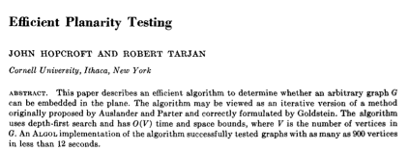
Planarity testing
Theorem. [Hopcroft-Tarjan 1974] There exists an O(n) time algorithm to determine whether a graph is planar.
simple planar graph
has at ≤ 3n edges
Notes:
http://www.planarity.org

Slide 12
Polynomial time detour
Graph minor theorem. [Robertson-Seymour 1980s] Pf of theorem. Tour de force.
Corollary. There exist an O(n³) algorithm to determine if a graph can be embedded in the torus in such a way that no two edges cross.
Mind boggling fact 1. The proof is highly nonconstructive!
Mind boggling fact 2. The constant of proportionality is enormous!
Theorem. There exists an explicit O(n) algorithm.
Practice. LEDA implementation guarantees O(n³).
more than 2↑2↑2↑(n/2)
“ Unfortunately, for any instance G = (V, E) that one could fit into the known
universe, one would easily prefer n⁷⁰ to even constant time, if that constant
had to be one of Robertson and Seymour's. ” — David Johnson
Notes:
proof published in a series of 23 papers of two decades
Juvan-Mohar 2005 = LEDA implementation
Juvan-Marincek-Mohar = linear time, but constant is still enormous
"The computation of the constant takes 9 steps, but most of the damage is concentrated in just three of them. Each is an application of some variant on the
"towers of 2s" generator t(k) where t(k) = 2^2^2^…2 [k times]. The first application computes a value θ₁ that is at least t(n/2). The second yields θ₂ which is
θ₁ tall. The third application yields a tower which is something like triply exponential in θ₂ . Still primitive recursive and slower than Ackermann's function."
Johnson, NP-Completeness Column #19
http://www2.research.att.com/~dsj/columns/col19.pdf

Slide 13
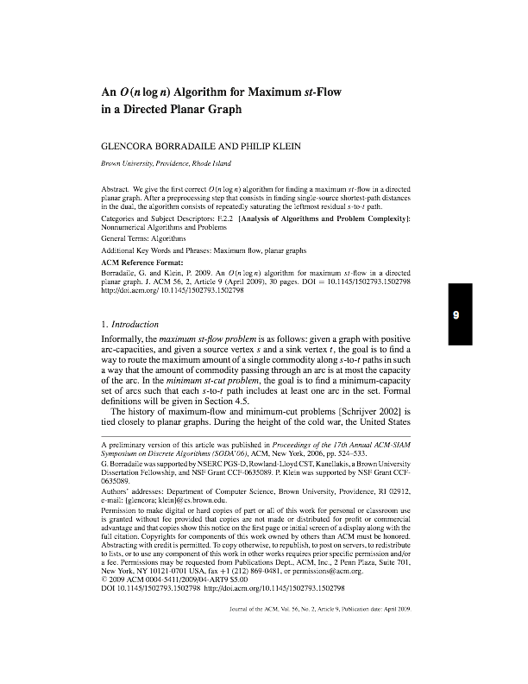
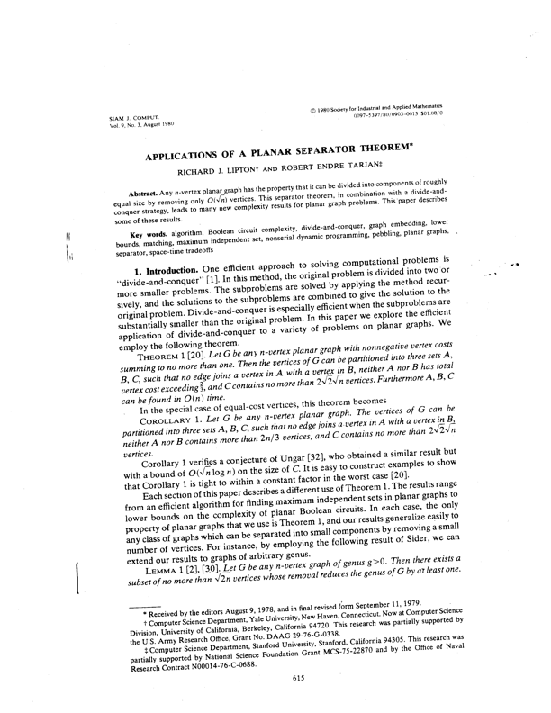
Problems on planar graphs
Fact 0. Many graph problems can be solved faster in planar graphs. Ex. Shortest paths, max flow, MST, matchings, …
Fact 1. Some NP-complete problems become tractable in planar graphs. Ex. Max-Cut, Ising, Clique, Graph-Isomorphism, 4-color, ...
Fact 2. Other NP-complete problems become easier in planar graphs. Ex. Independent-Set, Vertex-Cover, TSP, Steiner-Tree, ...
Notes:
shortest paths with nonnegative lengths can be solved in linear time in planar graphs
http://courses.csail.mit.edu/6.889/fall11/lectures/L01.pdf
max-cut becomes poly-time solvable in planar graphs
ising: http://www.brown.edu/Research/Istrail_Lab/media/ising_model_np_complete.pdf
many problems on planar graphs admit ptas or subexponential algorithms

Slide 14
Planar graph 3-colorability
Planar-3-Color. Given a planar graph, can it be colored using 3 colors so that no two adjacent nodes have the same color?

Slide 15
Planar map 3-colorability
Planar-Map-3-Color. Given a planar map, can it be colored using 3 colors so that no two adjacent regions have the same color?
yes instance

Slide 16
Planar map 3-colorability
Planar-Map-3-Color. Given a planar map, can it be colored using 3 colors so that no two adjacent regions have the same color?
no instance

Slide 17
Planar graph and map 3-colorability reduce to one another
Theorem. Planar-3-Color ≣ P Planar-Map-3-Color.
Pf sketch.
Nodes correspond to regions.
Two nodes are adjacent iff they share a nontrivial border.
e.g., not Arizona
and Colorado

Slide 18
Planar 3-colorability is NP-complete
Theorem. Planar-3-Color ∈ NP-complete.
Pf.
Easy to see that Planar-3-Color ∈ NP.
We show 3-Color ≤ P Planar-3-Color.
Given 3-Color instance G, we construct an instance of Planar-3-Color that is 3-colorable iff G is 3-colorable.

Slide 19
Planar 3-colorability is NP-complete
Lemma. W is a planar graph such that:
In any 3-coloring of W, opposite corners have the same color.
Any assignment of colors to the corners in which opposite corners have the same color extends to a 3-coloring of W.
planar gadget W

Slide 20
Planar 3-colorability is NP-complete
Lemma. W is a planar graph such that:
In any 3-coloring of W, opposite corners have the same color.
Any assignment of colors to the corners in which opposite corners have the same color extends to a 3-coloring of W.
Pf. The only 3-colorings (modulo permutations) of W are shown below. ▪
planar gadget W

Slide 21
Planar 3-colorability is NP-complete
Construction. Given instance G of 3-Color, draw G in plane, letting edges cross. Form planar G' by replacing each edge crossing with planar gadget W.
Lemma. G is 3-colorable iff G' is 3-colorable.
In any 3-coloring of W, a ≠ a' and b ≠ b'.
If a ≠ a' and b ≠ b' then can extend to a 3-coloring of W.
b
b
a
a'
a
a'
b'
a crossing
gadget W
b'
Notes:
[wayne s13] make proof go in both directions

Slide 22
Planar 3-colorability is NP-complete
Construction. Given instance G of 3-Color, draw G in plane, letting edges cross. Form planar G' by replacing each edge crossing with planar gadget W.
Lemma. G is 3-colorable iff G' is 3-colorable.
In any 3-coloring of W, a ≠ a' and b ≠ b'.
If a ≠ a' and b ≠ b' then can extend to a 3-coloring of W.
a
a'
a
W
W
W
a'
multiple crossings
concatenate copies of gadget W

Slide 23
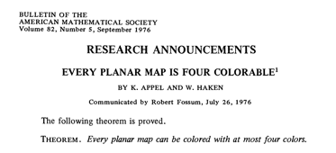
Planar map k-colorability
Theorem. [Appel-Haken 1976] Every planar map is 4-colorable.
Resolved century-old open problem.
Used 50 days of computer time to deal with many special cases.
First major theorem to be proved using computer.
Remarks.
Appel-Haken yields O(n⁴) algorithm to 4-color of a planar map.
Best known: O(n²) to 4-color; O(n) to 5-color.
Determining whether 3 colors suffice is NP-complete.
Notes:
Note: 4-color theorem doesn't directly apply to US map (Michigan + 4 corners).
special cases and configurations
Note: can 5-color a map in O(n) time. The O(n^2) algorithm is due to Robertson-Sanders-Seymour-Thomas.

Slide 24
Polynomial-time special cases NP-hard problems
Trees. Vertex-Cover, Independent-Set, Dominating-Set, Graph-Isomorphism, ...
Bipartite graphs. Vertex-Cover, 2-Color, ...
Chordal graphs. K-Color, Clique, Independent-Set, ... Planar graphs. Max-Cut, Ising, Clique, Graph-Isomorphism, 4-Color, ...
Bounded treewidth. 3-Color, Ham-Cycle, Independent-Set, Graph-Isomorphism. Small integers. Knapsack, Partition, Subset-Sum, ...
Notes:
r-by-r grid has treewidth r (in a sense, the only graph that has large treewidth)
Also poly-time on bounded treewidth: Tutte polynomial, Dominating set

Slide 25
10. Extending Tractability
special cases: trees
special cases: planarity
approximation algorithms
register allocation
exact exponential algorithms

Slide 26
Register allocation
Register. One of k of high-speed memory locations in computer's CPU.
Register allocator. Part of an optimizing compiler that controls which variables are saved in the registers as compiled program executes.
Interference graph. Nodes are "live ranges." Edge (u, v) if there exists an operation where both u and v are "live" at the same time.
Observation. [Chaitin 1982] Can solve register allocation problem iff interference graph is k-colorable.
Spilling. If graph is not k-colorable (or we can't find a k-coloring), we "spill" certain variables to main memory and swap back as needed.
say 32
variables or temporaries
typically infrequently used variables that are not in inner loops
Notes:
live range = value of a variable from definition to last usage

Slide 27
A useful property
Remark. Register allocation problem is NP-hard.
Key fact. If a node v in graph G has fewer than k neighbors, G is k-colorable iff G − { v } is k-colorable.
Pf. Delete node v from G and color G − { v }.
If G − { v } is not k-colorable, then neither is G.
If G − { v } is k-colorable, then ≥ 1 remaining color left for v. ▪
delete v and all incident edges
v
k = 3
k = 2
G is 2-colorable even though all nodes have degree 2

Slide 28
Chaitin's algorithm
Vertex-Color(G, k) {
while (G is not empty) {
Pick a node v with fewer than k neighbors
Push v on stack
Delete v and all its incident edges
}
while (stack is not empty) {
Pop next node v from the stack
Assign v a color different from its neighboring
nodes which have already been colored
}
}
say, node with fewest neighbors

Slide 29
Chaitin's algorithm
Theorem. [Kempe 1879, Chaitin 1982] Chaitin's algorithm produces a k-coloring of any graph with max degree k – 1.
Pf. Follows from key fact since each node has fewer than k neighbors.
Remark. If algorithm never encounters a graph where all nodes have degree ≥ k, then it produces a k-coloring.
Practice. Chaitin's algorithm (and variants) are extremely effective and widely used in real compilers for register allocation.
algorithm succeeds in k-coloring many graphs with max degree ≥ k

Slide 30
Intractability III
special cases: trees
special cases: planarity
approximation algorithms
exact exponential algorithms

Slide 31
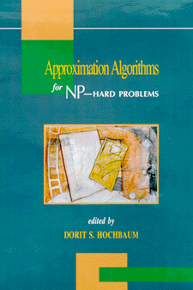
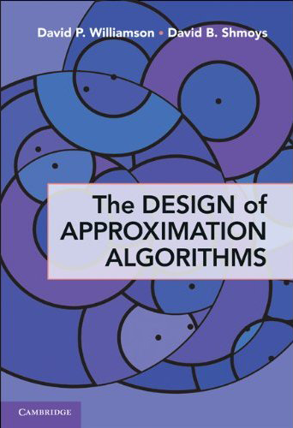
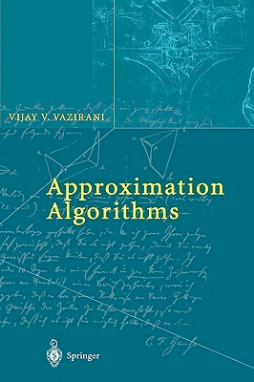
Approximation algorithms
ρ-approximation algorithm.
Guaranteed to run in poly-time.
Guaranteed to solve arbitrary instances of the problem.
Guaranteed to find solution within ratio ρ of true optimum.
Ex. Given a graph G, the greedy algorithms finds a Vertex-Cover that uses ≤ 2 OPT(G) vertices in O(m + n) time.
Challenge. Need to prove a solution's value is close to optimum value, without even knowing what optimum value is!
Notes:
greedy = find a maximal matching: choose an edge from G, add both endpoints to the vertex cover, and removes the two vertices (and all the edges adjacent to these two vertices) from G. Repeat until G has no edges.

Slide 32
Knapsack problem
Knapsack problem.
Given n objects and a knapsack.
Item i has value v_{i} > 0 and weighs w_{i} > 0.
Knapsack has weight limit W.
Goal: fill knapsack so as to maximize total value.
Ex: { 3, 4 } has value 40.
we assume wi ≤ W for each i
item | value | weight
1 | 1 | 1
2 | 6 | 2
3 | 18 | 5
4 | 22 | 6
5 | 28 | 7
original instance (W = 11)
Notes:
[wayne s13] see slides for Intractability III

Slide 33
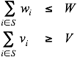
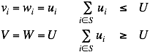
Knapsack is NP-complete
Knapsack. Given a set X, weights wi ≥ 0, values vi ≥ 0, a weight limit W, and a target value V, is there a subset S ⊆ X such that:
Subset-Sum. Given a set X, values ui ≥ 0, and an integer U, is there a subset S ⊆ X whose elements sum to exactly U ?
Theorem. Subset-Sum ≤ P Knapsack.
Pf. Given instance (u1, …, un, U) of Subset-Sum, create Knapsack instance:

Slide 34
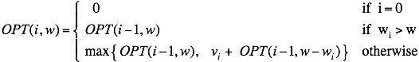
Knapsack problem: dynamic programming I
Def. OPT(i, w) = max value subset of items 1,..., i with weight limit w.
Case 1. OPT does not select item i.
OPT selects best of 1, …, i – 1 using up to weight limit w.
Case 2. OPT selects item i.
New weight limit = w – w_{i}.
OPT selects best of 1, …, i – 1 using up to weight limit w – w_{i}.
Theorem. Computes the optimal value in O(n W) time.
Not polynomial in input size.
Polynomial in input size if weights are small integers.

Slide 35
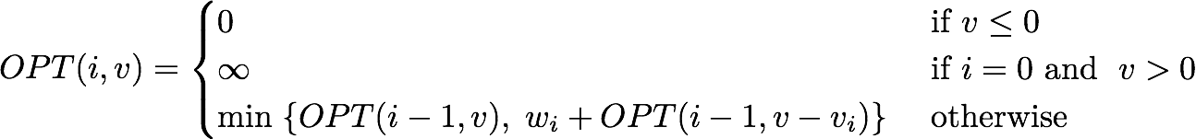
Knapsack problem: dynamic programming II
Def. OPT(i, v) = min weight of a knapsack for which we can obtain a solution of value ≥ v using a subset of items 1,..., i.
Note. Optimal value is the largest value v such that OPT(i, v) ≤ W.
Case 1. OPT does not select item i.
OPT selects best of 1, …, i – 1 that achieves value v.
Case 2. OPT selects item i.
Consumes weight w_{i}, need to achieve value v – v_{i}.
OPT selects best of 1, …, i – 1 that achieves value v – v_{i}.
Notes:
OPT(i, v) = \begin{cases}
0 &\mbox{ if } v \le 0 \\
\infty &\mbox{ if } i = 0 \mbox{ and } \; v > 0 \\
\min \; \{OPT(i-1, v), \; w_i + OPT(i-1, v - v_i) \} & \mbox{ otherwise }
\end{cases}

Slide 36
Knapsack problem: dynamic programming II
Theorem. Dynamic programming algorithm II computes the optimal value in O(n² vmax) time, where vmax is the maximum of any value.
Pf.
The optimal value V* ≤ n vmax.
There is one subproblem for each item and for each value v ≤ V*.
It takes O(1) time per subproblem. ▪
Remark 1. Not polynomial in input size!
Remark 2. Polynomial time if values are small integers.
Notes:
polynomial if values are small

Slide 37
Knapsack problem: polynomial-time approximation scheme
Intuition for approximation algorithm.
Round all values up to lie in smaller range.
Run dynamic programming algorithm II on rounded instance.
Return optimal items in rounded instance.
item | value | weight
1 | 934221 | 1
2 | 5956342 | 2
3 | 17810013 | 5
4 | 21217800 | 6
5 | 27343199 | 7
item | value | weight
1 | 1 | 1
2 | 6 | 2
3 | 18 | 5
4 | 22 | 6
5 | 28 | 7
original instance (W = 11)
rounded instance (W = 11)

Slide 38
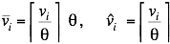
Knapsack problem: polynomial-time approximation scheme
Round up all values:
v_{max} = largest value in original instance.
ε = precision parameter.
θ = scaling factor = ε v_{max} / n.
Observation. Optimal solutions to problem with are equivalent to optimal solutions to problem with .
Intuition. close to v so optimal solution using is nearly optimal; small and integral so dynamic programming algorithm II is fast.

Slide 39
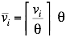
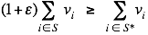
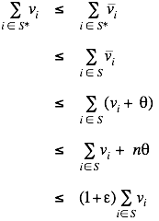
Knapsack problem: polynomial-time approximation scheme
Round up all values:
Theorem. If S is solution found by rounding algorithm and S* is any other feasible solution, then
Pf. Let S* be any feasible solution satisfying weight constraint.
always round up
solve rounded instance optimally
never round up by more than θ
| S | ≤ n
DP alg can take v_{max}
n θ = ε v_{max}, v_{max} ≤ Σ_{i ∈ S} v_{i}
Notes:
WLOG assume no individual item has weight w_n that exceeds weight limit W all by itself

Slide 40
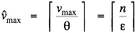
Knapsack problem: polynomial-time approximation scheme
Theorem. For any ε > 0, the rounding algorithm computes a feasible solution whose value is within a (1 + ε) factor of the optimum in O(n³ / ε) time.
Pf.
We have already proved the accuracy bound.
Dynamic program II running time is , where
PTAS. (1 + ε)-approximation algorithm for any constant ε > 0.
Produces arbitrarily high quality solution.
Trades off accuracy for time.
But such algorithms are unlikely to exist for certain problems...
Notes:
Knapsack.
Load balancing. [Hochbaum-Shmoys 1987]
Euclidean TSP. [Arora 1998, Mitchell 1999]

Slide 41
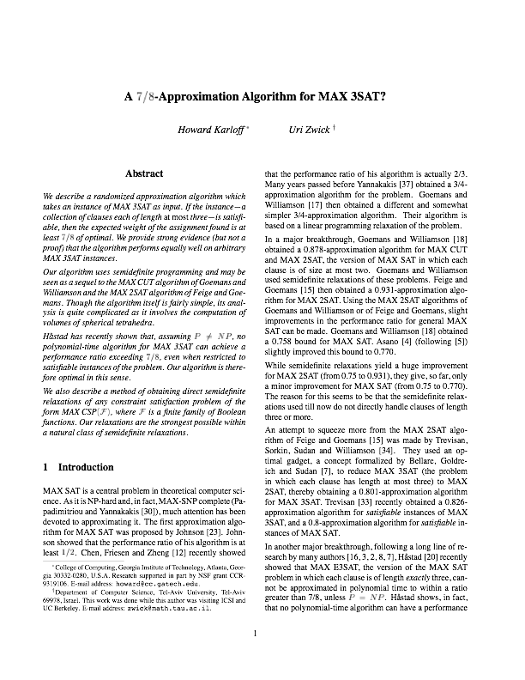
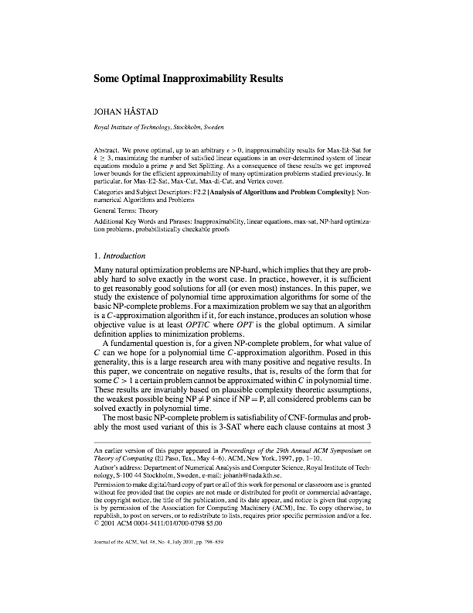
Inapproximability
Max-3-Sat. Given a 3-Sat instance Φ, find an assignment that satisfies the maximum number of clauses.
Theorem. [Karloff-Zwick 1997] There exists a ⅞-approximation algorithm.
Theorem. [Håstad 2001] Unless P = NP, there does not exist a ρ-approximation for any ρ > ⅞.
Notes:
clearly, max-3-sat is np-hard

Slide 42
Intractability III
special cases: trees
special cases: planarity
approximation algorithms
exact exponential algorithms

Slide 43
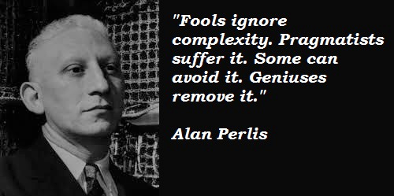
Exact exponential algorithms
Complexity theory deals with worst-case behavior.
Instances you want to solve may be "easy."
“ For every polynomial-time algorithm you have, there is an exponential
algorithm that I would rather run.” — Alan Perlis

Slide 44
Exact algorithms for 3-satisfiability
Brute force. Given a 3-Sat instance with n variables and m clauses, the brute-force algorithm takes O((m + n) 2^{n}) time.
Pf.
There are 2^{n} possible truth assignments to the n variables.
We can evaluate a truth assignment in O(m + n) time. ▪
Notes:
http://www.cs.uiuc.edu/~jeffe/teaching/algorithms/notes/04-fastexpo.pdf

Slide 45
Exact algorithms for 3-satisfiability
A recursive framework. A 3-Sat formula Φ is either empty or the disjunction of a clause (ℓ1 ∨ ℓ2 ∨ ℓ3 ) and a 3-Sat formula Φ' with one fewer clause.
Notation. Φ | x = true is the simplification of Φ by setting x to true.
Ex.
Φ = (x ∨ y ∨ ¬z) ∧ (x ∨ ¬y ∨ z) ∧ (w ∨ y ∨ ¬z) ∧ (¬x ∨ y ∨ z).
Φ' = (x ∨ ¬y ∨ z) ∧ (w ∨ y ∨ ¬z) ∧ (¬x ∨ y ∨ z).
(Φ' | x = true) = (w ∨ y ∨ ¬z) ∧ (y ∨ z).
Φ | = | (ℓ1 ∨ ℓ2 ∨ ℓ3) ∧ Φ'
 | = | (ℓ1 ∧ Φ') ∨ (ℓ2 ∧ Φ') ∨ (ℓ3 ∧ Φ')
 | = | (Φ' | ℓ1 = true) ∨ (Φ' | ℓ2 = true) ∨ (Φ' | ℓ3 = true)
each clause has ≤ 3 literals
Notes:
http://www.cs.uiuc.edu/~jeffe/teaching/algorithms/notes/04-fastexpo.pdf

Slide 46
Exact algorithms for 3-satisfiability
A recursive framework. A 3-Sat formula Φ is either empty or the disjunction of a clause (ℓ1 ∨ ℓ2 ∨ ℓ3 ) and a 3-Sat formula Φ' with one fewer clause.
Theorem. The brute-force 3-Sat algorithm takes O(poly(n) 3^{n}) time.
Pf. T(n) ≤ 3T(n – 1) + poly(n). ▪
3-Sat (Φ)
______________________________________________________________________________________________________________________________________________________________________________________________________________________________________________________________________________________________________________________________________________________________________________________________________________________________________________________________________________________________________________________________________________________________________________________________________________________________________________________________________________________________________________________________________________________________________________________________
If Φ is empty Return true.
(ℓ1 ∨ ℓ2 ∨ ℓ3) ∧ Φ' ← Φ.
If 3-Sat(Φ' | ℓ1 = true) Return true.
If 3-Sat(Φ' | ℓ2 = true) Return true.
If 3-Sat(Φ' | ℓ3 = true) Return true.
Return false.
______________________________________________________________________________________________________________________________________________________________________________________________________________________________________________________________________________________________________________________________________________________________________________________________________________________________________________________________________________________________________________________________________________________________________________________________________________________________________________________________________________________________________________________________________________________________________________________________
Notes:
http://www.cs.uiuc.edu/~jeffe/teaching/algorithms/notes/04-fastexpo.pdf

Slide 47
Exact algorithms for 3-satisfiability
Key observation. The cases are not mutually exclusive. Every satisfiable assignment containing clause (ℓ1 ∨ ℓ2 ∨ ℓ3 ) must fall into one of 3 classes:
ℓ1 is true.
ℓ1 is false; ℓ2 is true.
ℓ1 is false; ℓ2 is false; ℓ3 is true.
3-Sat (Φ)
______________________________________________________________________________________________________________________________________________________________________________________________________________________________________________________________________________________________________________________________________________________________________________________________________________________________________________________________________________________________________________________________________________________________________________________________________________________________________________________________________________________________________________________________________________________________________________________________________________________________________________________________________________________________________________________________________________________________________________________________________________________________________________________________________________________________________________________________________________________________________________________________________________________________________________
If Φ is empty Return true.
(ℓ1 ∨ ℓ2 ∨ ℓ3 ) ∧ Φ' ← Φ.
If 3-Sat(Φ' | ℓ1 = true ) Return true.
If 3-Sat(Φ' | ℓ1 = false, ℓ2 = true) Return true.
If 3-Sat(Φ' | ℓ1 = false, ℓ2 = false, ℓ3 = true) Return true.
Return false.
______________________________________________________________________________________________________________________________________________________________________________________________________________________________________________________________________________________________________________________________________________________________________________________________________________________________________________________________________________________________________________________________________________________________________________________________________________________________________________________________________________________________________________________________________________________________________________________________________________________________________________________________________________________________________________________________________________________________________________________________________________________________________________________________________________________________________________________________________________________________________________________________________________________________________________
Notes:
http://www.cs.uiuc.edu/~jeffe/teaching/algorithms/notes/04-fastexpo.pdf
http://www.win.tue.nl/~gwoegi/papers/exact.pdf

Slide 48
Exact algorithms for 3-satisfiability
Theorem. The brute-force algorithm takes O(1.84^{n}) time.
Pf. T(n) ≤ T(n – 1) + T(n – 2) + T(n – 3) + O(m + n). ▪
largest root of r³ = r² + r + 1
3-Sat (Φ)
______________________________________________________________________________________________________________________________________________________________________________________________________________________________________________________________________________________________________________________________________________________________________________________________________________________________________________________________________________________________________________________________________________________________________________________________________________________________________________________________________________________________________________________________________________________________________________________________________________________________________________________________________________________________________________________________________________________________________________________________________________________________________________________________________________________________________________________________________________________________________________________________________________________________________________
If Φ is empty Return true.
(ℓ1 ∨ ℓ2 ∨ ℓ3 ) ∧ Φ' ← Φ.
If 3-Sat(Φ' | ℓ1 = true ) Return true.
If 3-Sat(Φ' | ℓ1 = false, ℓ2 = true) Return true.
If 3-Sat(Φ' | ℓ1 = false, ℓ2 = false, ℓ3 = true) Return true.
Return false.
______________________________________________________________________________________________________________________________________________________________________________________________________________________________________________________________________________________________________________________________________________________________________________________________________________________________________________________________________________________________________________________________________________________________________________________________________________________________________________________________________________________________________________________________________________________________________________________________________________________________________________________________________________________________________________________________________________________________________________________________________________________________________________________________________________________________________________________________________________________________________________________________________________________________________________
Notes:
http://www.cs.uiuc.edu/~jeffe/teaching/algorithms/notes/04-fastexpo.pdf

Slide 49
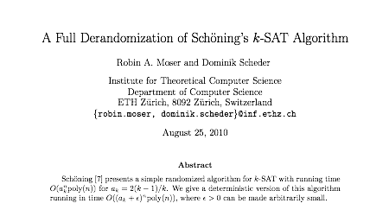
Exact algorithms for 3-satisfiability
Theorem. There exists a O(1.33334 ^{n}) deterministic algorithm for 3-Sat.
Notes:
Theorem. There exists a O(1.7321 n) algorithm for 3-Sat.

Slide 50
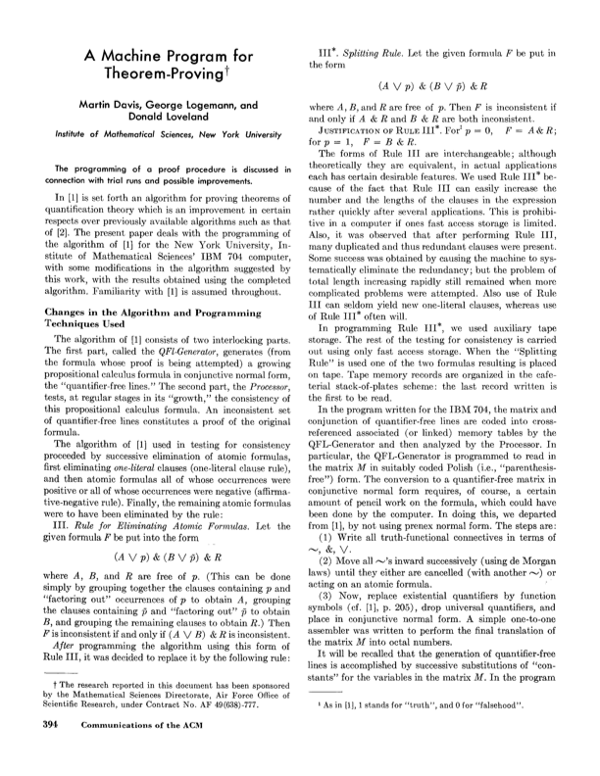
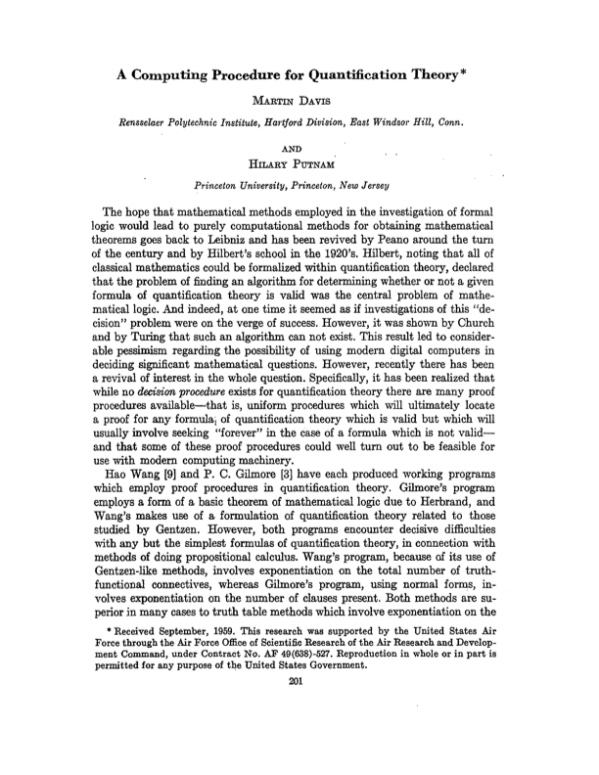
Exact algorithms for satisfiability
DPPL algorithm. Highly-effective backtracking procedure.
Splitting rule: assign truth value to literal; solve both possibilities.
Unit propagation: clause contains only a single unassigned literal.
Pure literal elimination: if literal appears only negated or unnegated.

Slide 51
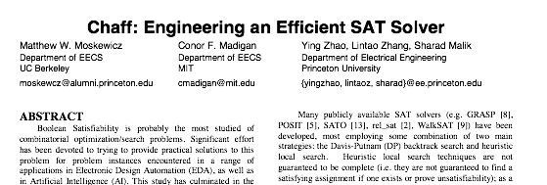
Exact algorithms for satisfiability
Chaff. State-of-the-art Sat solver.
Solves real-world Sat instances with ~ 10K variable. Developed at Princeton by undergrads.
Notes:
Chaff = state-of-the-art SAT solver developed at Princeton by two undergrads for independent work! Matthew Moskewicz '00, Conor Madigan '00, Sharad Malik]
http://www.princeton.edu/pr/pwb/01/0305/1b.shtml

Slide 52
Exact algorithms for TSP and Hamilton cycle
Theorem. The brute-force algorithm for TSP (or Ham-Cycle) takes O(n!) time.
Pf.
There are ½ (n – 1)! tours.
Computing the length of a tour takes O(n) time. ▪
Note. The function n! grows exponentially faster than 2^{n}.
2⁴⁰ = 1099511627776 ~ 10¹².
40! = 815915283247897734345611269596115894272000000000 ~ 10⁴⁸ .

Slide 53
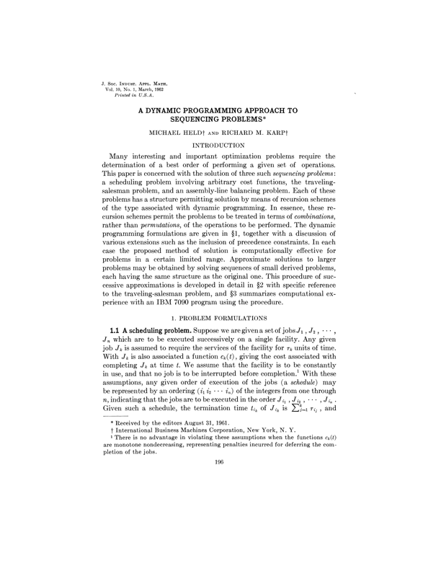
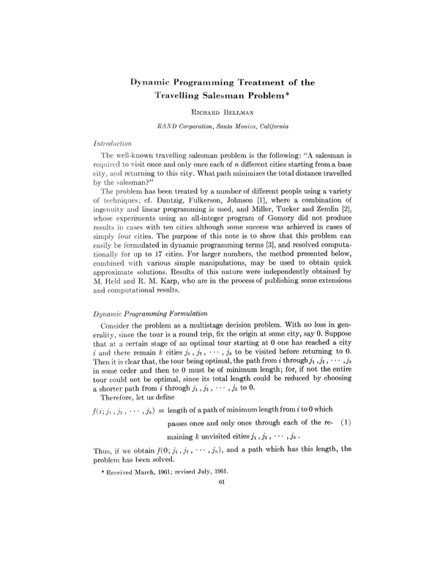
Exact algorithms for TSP and Hamilton cycle
Theorem. [Bellman 1962, Held-Karp 1962] There exists a O(n² 2^{n}) time algorithm for TSP (and Hamilton-Cycle).

Slide 54
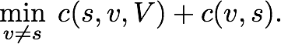
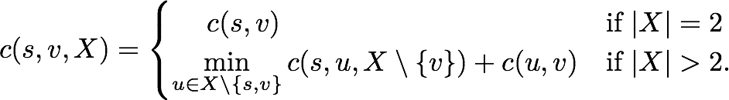
Exact algorithms for TSP and Hamilton cycle
Theorem. [Bellman 1962, Held-Karp 1962] There exists a O(n² 2^{n}) time algorithm for TSP (and Hamilton-Cycle).
Pf. [dynamic programming]
Define c(s, v, X) = cost of cheapest path between s and v that visits every node in X exactly once (and uses only nodes in X).
Observe OPT =
There are n 2^{n} subproblems and they satisfy the recurrence:
The values c(s, v, X) can be computed increasing order of the cardinality of X. ▪
u
v
s
Notes:
\min_{u \neq s} \; c(s, u, V) + c(s, u)
c(s, v, X) = \begin{cases}
\quad \; c(s, v) & \mbox{if } |X| = 2 \\
\min\limits_{u \in X \setminus \{s, v\}} c(s, u, X \setminus \{ v \} ) + c(u, v) & \mbox{if } |X| > 2.
\end{cases}

Slide 55
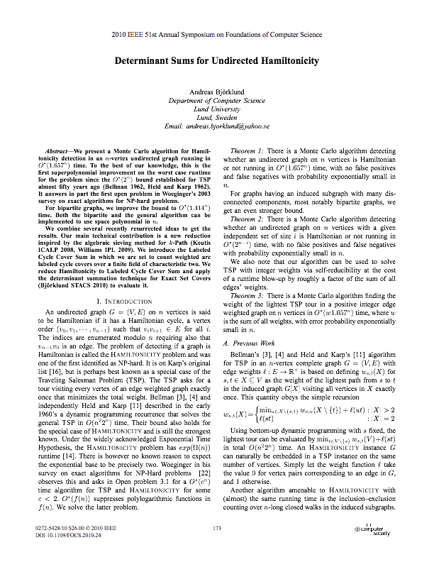
Exact algorithms for Hamilton cycle
Theorem. [Björklund 2010] There exists a O(1.657 ^{n}) time randomized algorithm for Hamilton-Cycle.
Notes:
http://www.cs.uiuc.edu/~jeffe/teaching/algorithms/notes/04-fastexpo.pdf
unknown whether 2^n can be improved for TSP

Slide 56
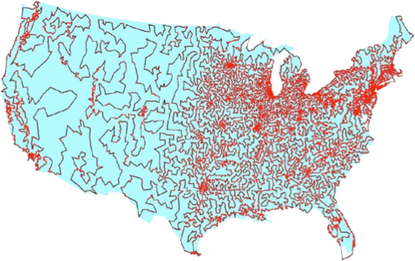
Euclidean traveling salesperson problem
Euclidean TSP. Given n points in the plane and a real number L, is there a tour that visit every city exactly once that has distance ≤ L ?
Proposition. Euclidean-TSP is NP-hard.
Remark. Not known to be in NP.
8.928198407 < 8.928203230
13509 cities in the USA and an optimal tour
Notes:
\sqrt{5} + \sqrt{6} + \sqrt{18} \;<\; \sqrt{4} + \sqrt{12} + \sqrt{12}

Slide 57
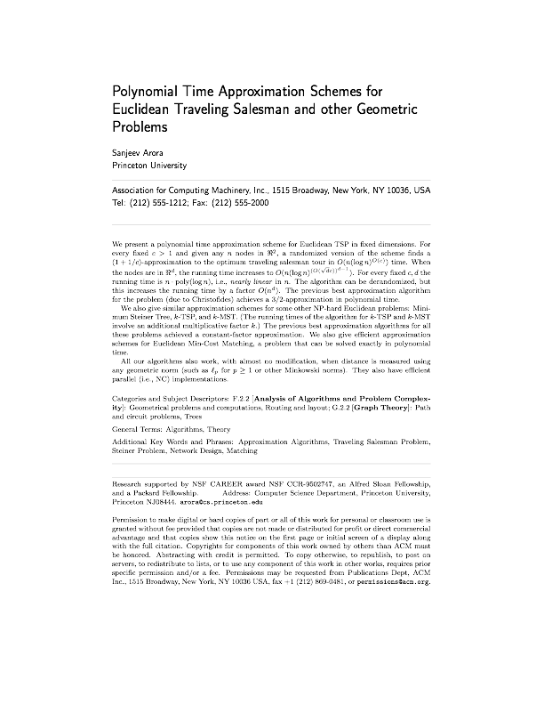
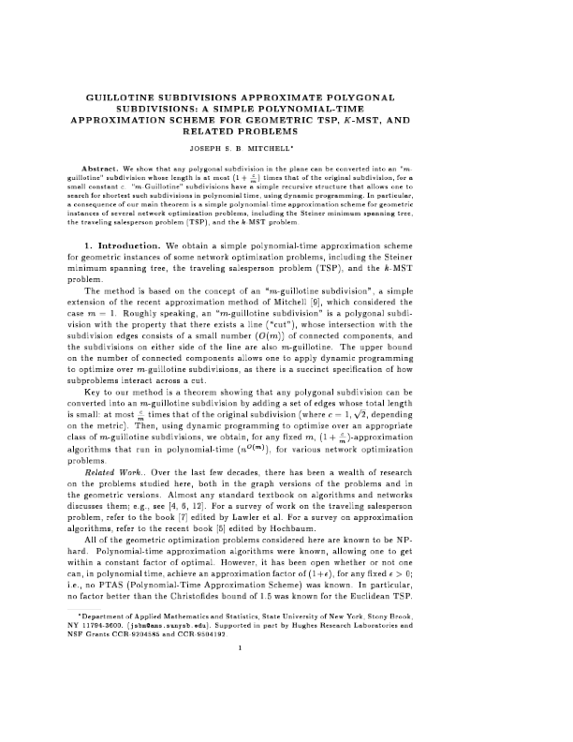
Euclidean traveling salesperson problem
Theorem. [Arora 1998, Mitchell 1999] Given n points in the plane, for any constant ε > 0, there exists a poly-time algorithm to find a tour whose length is at most (1 + ε) times that of the optimal tour.
Pf idea. Structure theorem + dynamic programming.

Slide 58
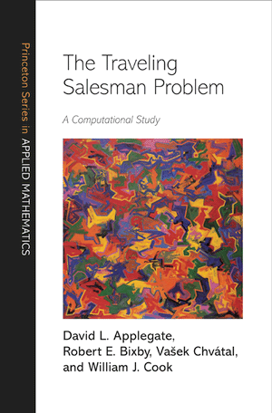
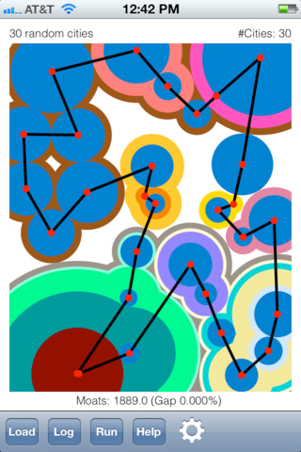
Concorde TSP solver
Concorde TSP solver. [Applegate-Bixby-Chvátal-Cook]
Linear programming + branch-and-bound + polyhedral combinatorics.
Greedy heuristics, including Lin-Kernighan.
MST, Delaunay triangulations, fractional b-matchings, ...
Remarkable fact. Concorde has solved all 110 TSPLIB instances.
Notes:
largest had 85,900 cities
industrial-strength ANSI C code. Uses CPLEX.

Slide 59
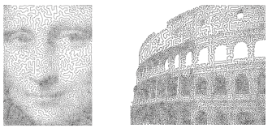
TSP line art
Continuous line drawings via the TSP by Robert Bosch and Craig Kaplan

Slide 60

That’s all, folks: keep searching!
Woh-oh-oh-oh, find the longest path!
Woh-oh-oh-oh, find the longest path!
I have been hard working for so long.
I swear it's right, and he marks it wrong.
Some how I'll feel sorry when it's done: GPA 2.1
Is more than I hope for.
If you said P is NP tonight,
There would still be papers left to write.
I have a weakness;
I'm addicted to completeness,
And I keep searching for the longest path.
Garey, Johnson, Karp and other men (and women)
Tried to make it order N log N.
Am I a mad fool
If I spend my life in grad school,
Forever following the longest path?
The algorithm I would like to see
Is of polynomial degree.
But it's elusive:
Nobody has found conclusive
Evidence that we can find a longest path.
Woh-oh-oh-oh, find the longest path!
Woh-oh-oh-oh, find the longest path!
Woh-oh-oh-oh, find the longest path.
Written by Dan Barrett in 1988 while a student
at Johns Hopkins during a difficult algorithms take-home final
Notes:
http://www.cs.princeton.edu/~wayne/cs423/lectures/longest-path.mp3

